Slide 1


Team MoRNINGSTARS
Challenge – Graph & FHIR

Slide 2


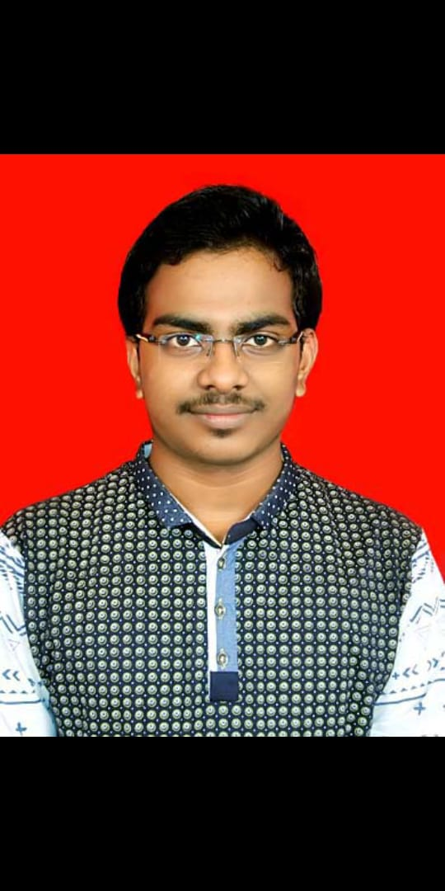
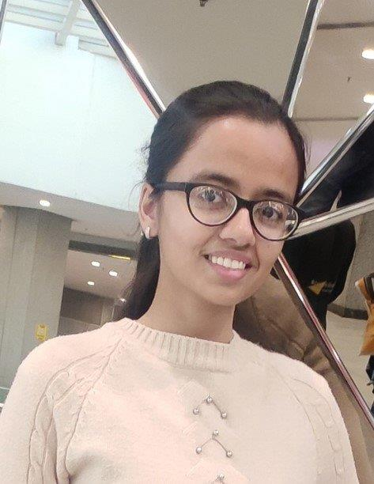
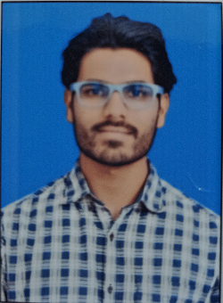
Team Member Profiles
Rajat Kumar
BANGALORE
Software Engineer| Travelling| |Cooking
Animesh Banerjee
BANGALORE
Software Engineer | Music| Travelling |Cricket
Jyoti R Mohapatra
Hyderabad
Software Engineer | Travelling | Gardening
SOFTWARE ENGINEER
SOFTWARE ENGINEER
SOFTWARE ENGINEER
Megha Jain
Gurugram
Software Engineer | Music| Travelling |Cricket
Ashish Patidar
Gurugram
Software Engineer | Cooking| Gardening
SOFTWARE ENGINEER
SOFTWARE ENGINEER

Slide 3
Problem statement
Health Care industry exposure is limited to few developers, limits development capability.
Existing Old Healthcare Data Standards are very complex.
Difficult for the developer to develop applications.
Restricts Open Source Developments & Hold on Personal HealthCare Data.
FHIR Standards enables quick understanding yet confusing.
Not understood by non-functional devs due to complex structure.

Slide 4
What problem does our project solves!
Better understanding of Healthcare architecture [without compromising abstraction].
End to End Understanding of FHIR Standards.
Enables end user to have better hold and functionalities of HealthCare Data.
Quick understanding relations and structures of HC data according to FHIR Standards.
Opens up pathway for Open Source Contributors.
Helps in booming HealthCare's IT industry.

Slide 5

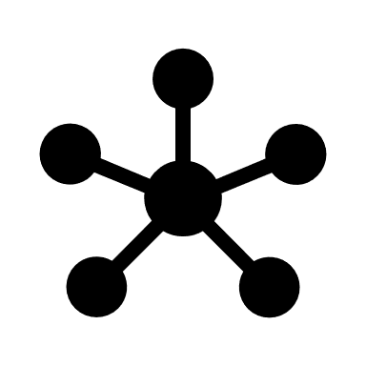

Generalized Architecture
FHIR Server
[Custom Build according to organizational standards]
Existing Databases
[In Case of Organizations using Legacy Structure]
REST API
Front-End Application
[Mobile/Web App]
REST API
Graph API/Connectors
Graph Database
Middleware to Sync Data
Scope: Open Source Devs
Scope: Organization

Slide 6


OUR Architecture
Google Cloud Compute Instances
End User
Tech: ReactJs
Hosted On: Azure App Services
Django
TigerGraph
FrontEnd

Slide 7
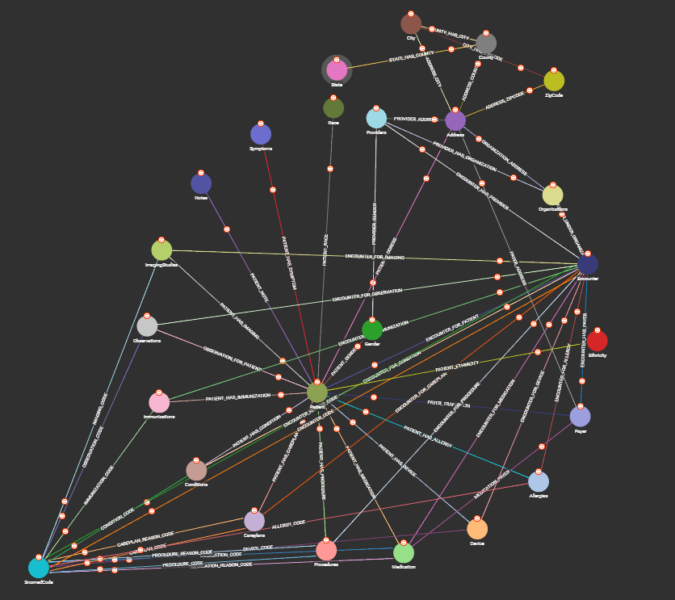
Suggested Graph Structure

Slide 8
Data SOURCE
https://synthetichealth.github.io/synthea/

Slide 9
Thank you

